Slide 1
STUDENT NAME: ARUN PRASATH M
REGISTER NO AND NMID: 222402587 – asunm161222402587
DEPARTMENT: DATA SCIENCE
COLLEGE: COLLEGE/ UNIVERSITY PRINCE SHRI VENKATESHWARA ARTS AND SCIENCE COLLEGE. MADRAS UNIVERSITY

Slide 2
PROJECT TITLE
DIGITAL JOURNEY

Slide 3
AGENDA
Problem Statement
Project Overview
End Users
Tools and Technologies
Portfolio design and Layout
Features and Functionality
Results and Screenshots
Conclusion
Github Link

Slide 4
PROBLEM STATEMENT
Showcasing Projects Effectively Graduates typically complete numerous projects during their studies but often struggle to present them in a structured and visually appealing format.
Paper resumes cannot display live demos, visuals, or interactive content, which limits the impact of their work.
A portfolio website organizes projects clearly, highlights key contributions, and allows viewers to interact with live demonstrations, making the candidate’s abilities more tangible and impressive.

Slide 5
PROJECT OVERVIEW
Interactive Skills PortfolioThis version of the portfolio focuses on highlighting my technical and analytical abilities, particularly in Data Science.
Unlike a basic portfolio, this one uses interactive visuals such as progress bars, charts, and skill indicators to make the information more engaging.
Visitors can quickly identify my strengths and expertise in different areas, making it easier for potential recruiters, mentors, or collaborators to assess my knowledge.
Alongside the skill-focused sections, it also includes About Me, Education, Hobbies, and Contact, all visually supported by my profile image.
Overall, this portfolio emphasizes a dynamic, visually appealing way to showcase my skills and makes my capabilities more memorable

Slide 6
WHO ARE THE END USERS?
College Faculty and Mentors My portfolio also serves as a valuable tool for college faculty members and academic mentors.
By reviewing my academic progress, completed projects, and skill development, they can provide better guidance and career advice.
It allows them to track my growth over time and suggest areas of improvement, making it an effective medium for academic evaluation.

Slide 7
TOOLS AND TECHNIQUES
HTML → For writing the content such as About Me, Education, Skills, and Hobbies.
CSS → For formatting text, setting background colors, and styling images.
Web Browser → To test and view the portfolio while developing.
GitHub → To upload and make the portfolio publicly available.

Slide 8
POTFOLIO DESIGN AND LAYOUT
Each section (Home, About Me, Skills, Education, Hobbies, Contact) inside a separate box with border and background color.
Profile image shown in the Home section.
Education written as plain text or list of qualifications
Responsive → Boxes stack one below the other neatly on small screens.

Slide 9
FEATURES AND FUNCTIONALITY
Navigation bar with smooth scrolling – helps to move across sections easily.
Project showcase with details – highlights my academic and personal works.
Interactive hover effects – makes the portfolio engaging to explore.
Responsive design – adjusts neatly on all devices.
Organized layout – keeps sections clear and simple.

Slide 10
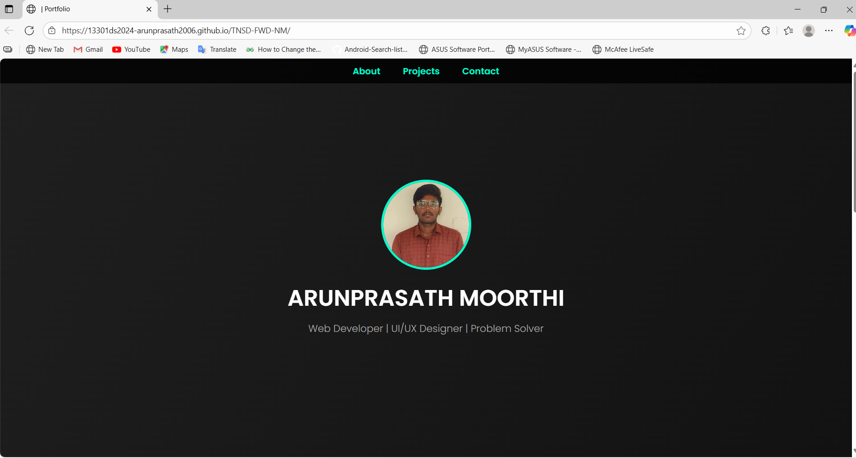
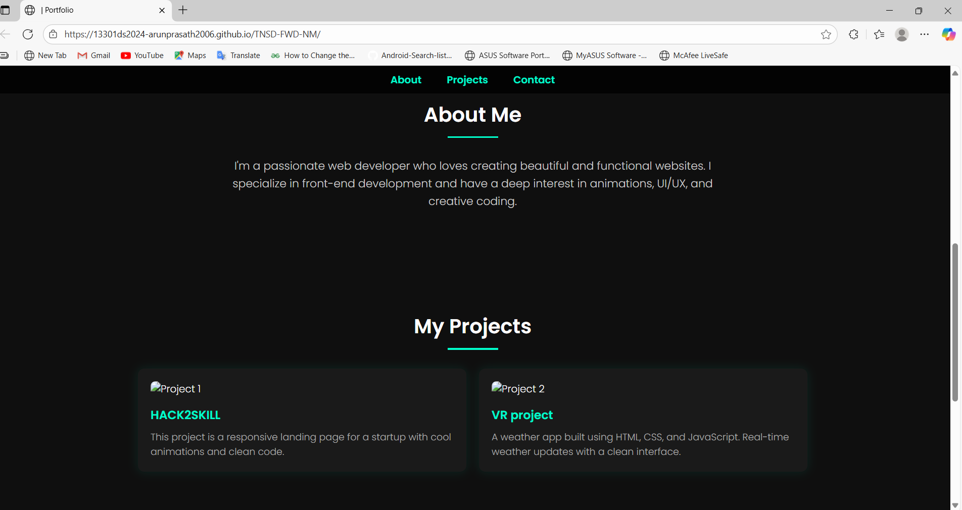
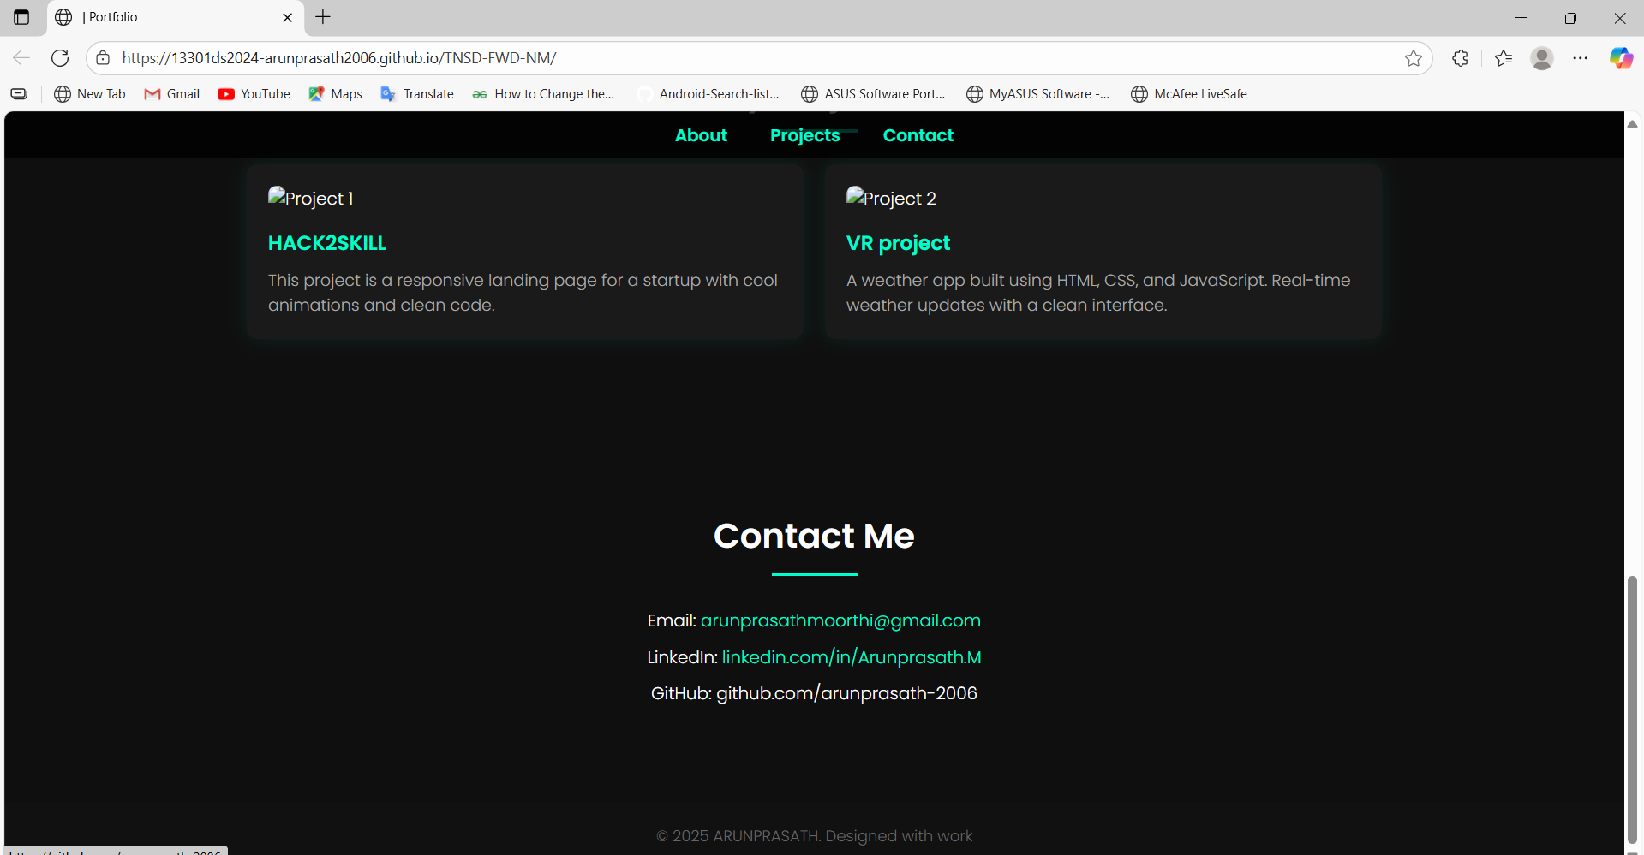
RESULTS AND SCREENSHOTS

Slide 11
CONCLUSION
My portfolio is a simple way to showcase myself.It includes my education, skills, hobbies, and profile.The design is neat and easy to understand.It works on all devices with a responsive layout.This portfolio reflects my learning and growth.
GITHUB: https://13301ds2024-arunprasath2006.github.io/TNSD-FWD-NM/

